Slide 1

Chapter 1 Slides
Introduction to Computer Science
PowerPoint Presentation
created by:
Mr. John L. M. Schram
and Mr. Leon Schram

Slide 2
Section 1.1
How Do
Computers Work?

Slide 3
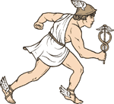
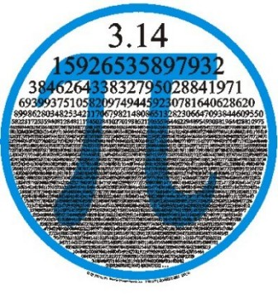
Three Ways Where Computers Beat People
Computers are faster.
Computers are more accurate.
Computers do not forget.

Slide 4
Section 1.2
Messages with
Morse Code

Slide 5
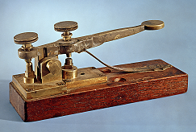
First Five Letters In Morse code
A | ▀ ▀▀▀ | short - long
B | ▀▀▀ ▀ ▀ ▀ | long - short - short - short
C | ▀▀▀ ▀ ▀▀▀ ▀ | long - short - long - short
D | ▀▀▀ ▀ ▀ | long - short - short
E | ▀ | short

Slide 6
Section 1.3
Electronic
Memory

Slide 7
Electronic Memory
off | on | off | off | off | off | off | on
0 | 1 | 0 | 0 | 0 | 0 | 0 | 1

Slide 8
0-31 in Bases 10 & 2
Base 10 | Base-2 | Base 10 | Base-2
0 | 0 | 16 | 10000
1 | 1 | 17 | 10001
2 | 10 | 18 | 10010
3 | 11 | 19 | 10011
4 | 100 | 20 | 10100
5 | 101 | 21 | 10101
6 | 110 | 22 | 10110
7 | 111 | 23 | 10111
8 | 1000 | 24 | 11000
9 | 1001 | 25 | 11001
10 | 1010 | 26 | 11010
11 | 1011 | 27 | 11011
12 | 1100 | 28 | 11100
13 | 1101 | 29 | 11101
14 | 1110 | 30 | 11110
15 | 1111 | 31 | 11111

Slide 9
Three Combinations of 8 Light Bulbs
01000001 (base-2) =
65 (base 10) or char A
0 | 1 | 0 | 0 | 0 | 0 | 0 | 1
01000010 (base-2) =
66 (base 10) or char B
0 | 1 | 0 | 0 | 0 | 0 | 1 | 0
01000011 (base-2) =
67 (base 10) or char C
0 | 1 | 0 | 0 | 0 | 0 | 1 | 1

Slide 10
Bits, Bytes & Codes
Bit is a Binary digit that is either 0 (off) or 1 (on).
1 Nibble = 4 bits
1 Byte = 8 bits.
1 Byte has 256 different numerical combinations.
2 Bytes has 65,536 different numerical combinations.
ASCII uses one byte to store one character.
Unicode uses two bytes to store one character.

Slide 11
Section 1.4
Memory and
Secondary Storage

Slide 12
Motherboard & Computers Chips
motherboard
The main board with all the primary computer components. Has several computer chips attached:
Read Only Memory (ROM)
This chip stores permanent information for the computer.
Random Access Memory (RAM)
This chip stores temporary information for the computer.
Central Processing Unit (CPU)
This chip is the “brains” of the computer.

Slide 13
Measuring Memory
KB | Kilo Byte | 1 thousand bytes
MB | Mega Byte | 1 million bytes
GB | Giga Byte | 1 billion bytes
TB | Tera Byte | 1 trillion bytes
PB | Peta Byte | 1 quadrillion bytes
EB | Exa Byte | 1 quintillion bytes
Note: Technically, a kilobyte is exactly 2¹⁰ or 1024 bytes.

Slide 14
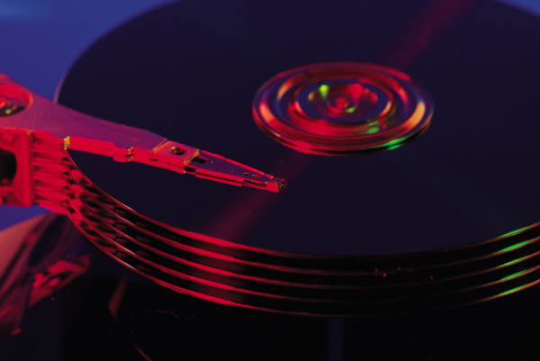

Secondary Storage Devices
Since RAM is lost when the computer is turned off, files must be saved to some secondary storage device for later use.

Slide 15
Section 1.5
What is
Programming?

Slide 16
Program Definition
A program is a sequence of instructions that makes a computer perform a desired task.
A programmer is a person who writes a program for a computer.

Slide 17
Programming in Machine Code
Programming the first computers was an unbelievably difficult task.
Individual vacuum tubes had to be switched on or off.
Instructions were sequenced by physically plugging wires from one computer memory segment to another.
Later computers allowed tape and cards to be used for program input.
Still, thousands of 1s and 0s that had to be entered.
Mistakes were very easily made, and very difficult to detect.

Slide 18
Section 1.6
Programming
Languages

Slide 19
Interpreters & Compilers
Grace Hopper, a Navy lieutenant, was largely instrumental for developing translating programs that allow programming in a human-style language.
Two types of translating programs were created:
An interpreter translates a program one line at a time during execution.
A compiler translates the entire program into a machine code file and then executes the file.
The majority of today’s program languages use compilers for translators.
Java, oddly enough, is both a compiled and an interpretive language. How this is possible will be explained soon.

Slide 20
Types of Languages
High-Level Language
Languages that are closer to human languages.
Examples: BASIC, Pascal, COBOL, FORTRAN,
PL/1, C, C++, Java
Low-Level Language
Languages that are very close to binary code.
Examples: Machine Code and Assembly Language
A translator (interpreter or compiler) translates a High-level language into a Low-Level language.

Slide 21
FORTRAN
The first successful programming language -- released in 1956.
FORTRAN stands for FORmula TRANslation
Designed for the mathematics and scientific community.
It could not handle the record processing required for the business world.

Slide 22
COBOL
Created in 1960 (largely by Grace Hopper) for the business community and the armed forces.
COBOL stands for COmmon Business Oriented Language.
COBOL became extremely successful when the Department of Defense adopted COBOL as its official programming language.

Slide 23
PL/1
PL/1 stands for Programming Language 1
It tried to be a language for everybody by combining all of the Math features of FORTRAN with all of the business features of COBOL.
The result was an extremely cumbersome language that never gained much popularity.

Slide 24
BASIC
BASIC stands for Beginner All-purpose Symbolic Instructional Code
Was designed for beginning college students.
BASIC became the first popular program language for personal computers in the 1970s.
BASIC required little memory, and it was the only language that could initially be handled by the first micro computers.

Slide 25
Pascal
Pascal was named after Blaise Pascal
(the same guy who created Pascal’s Triangle).
In the late seventies, early eighties, Pascal took a strong hold in the educational community.
Pascal was developed by Niklaus Wirth, specifically for the purpose of teaching proper computer science programming techniques.
For many years Pascal was the language taught in APCS1 & APCS2.

Slide 26
C and C++
The UNIX operating system was developed at the Bell laboratories and was written in several languages including BCPL or just plain B.
A later version of the language was called C.
A new era with a powerful programming technique was born called Object Oriented Programming (OOP).
Bjarne Stroustrup combined the popularity of the existing C language with the demands for OOP and developed C++.

Slide 27

Java
Released in 1995 by Sun Microsystems.
Java is a Platform Independent Language.
Platform Independent means that the language does not cause problems as programs are transported between different hardware and software platforms.
Unlike C++, Java required you to use OOP which caused many universities to adopt it.
This caused Java to be the official language for the APCS Exam starting in the 2003-2004 school year.
In 2009 Oracle purchased Sun Microsystems.
Java has continued to improve in the same manner as when Sun Microsystems owned the company.

Slide 28
Section 1.7
Networking

Slide 29
SneakerNet
Early personal computers were not networked at all.
Every computer was a stand-alone computer.
Some computers were hooked up to printers and many others were not.
If you needed to print something, and you were not directly connected to a printer, you saved your work to a floppy disk, put on your sneakers, and walked to the printing computer.
Sharing files was done in the same way.

Slide 30
Peer-To-Peer Networks
The first practical networks for personal computers were peer-to-peer networks.
These are small groups of computers with a common purpose all connected to each other.
These types of networks were frequently called Local Area Networks or LANs.
Initially, the networks were true peer-to-peer networks.
This means that every computer on the network was equal.

Slide 31
Client-Server Networks
A server is a specialty computer that is connected to the LAN for one or more purposes.
It services the other computers in the network which are called clients.
Servers can be used for printing, logon authentications, permanent data storage and communication.
Server
Client
Client
Client

Slide 32
The Department of Defense
The Internet has existed since the 1960s and has its origins in the "Cold War.“ During the Cold War there was a major concern about the country being paralyzed by a direct nuclear hit on the Pentagon.
A means of communication had
to be created that was capable
to keep working regardless of
damage created anywhere.
This was the birth of the Internet.
The Internet has no central
location where all the control
computers are located.
Any part of the Internet can be
damaged and all information will
then travel around the damaged area.
Many people confuse the
World Wide Web with the Internet.
WWW came out in the 1990s
and is a PART of the Internet.

Slide 33
The Modern Internet
Normally, businesses and schools have a series of LANs that all connect into a large network called an Intranet.
An Intranet behaves like the Internet on a local business level.
This promotes security, speed and saves cost.
Now the moment a school, a business, your home, wants to be connected to the outside world and giant world-wide network known as the Internet, you have access to millions of lines of telecommunications.
This will cost money and every person, every school, every business, who wants this access needs to use an Internet Service Provider or ISP.
You pay a monthly fee to the ISP for the Internet connection.
The amount of money you pay depends on the speed of your Internet connection.

Slide 34
Section 1.8
Hardware &
Software

Slide 35
Hardware
Hardware refers to physical pieces of computer equipment.
This included the main computer system unit, as well as all of the peripherals (things that plug into the computer.)

Slide 36
Software
Software provides instructions to a computer.
The most important aspect of this course is to learn how to give correct and logical instructions to a computer with the help of a programming language.
Software falls into two categories:
System Software
Application Software.
The major Operating Systems are Windows, UNIX, Linux and the MAC OS. These are all examples of System Software.
Applications software runs an application on a computer.
Examples of Application Software are Word, Excel, PowerPoint, Video Games, and the very programs that you will write in this course.

